Slide 1



The Future of Music Investment-Leveraging Data Analytics for hit song production
Team 2: Unparalleled
Ivan Chichikin, Dindo Marco Dioso, Ted Mao,
Isha Deshmukh, Archita Dhande, Shalini Kumari
DSO-528, Blended data Analytics-Final presentation

Slide 2






Team Members
Ivan Chichikin
Isha Deshmukh
Ted Mao
Dindo Marco Dioso
Archita Dhande
Shalini Kumari

Slide 3


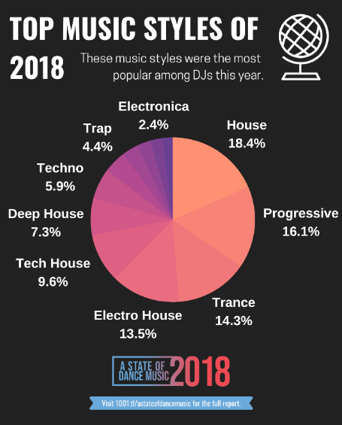

Agenda
1
2
3
4
Business context
EDA insights
Model Comparisons
Recommendations

Slide 4

Transforming Music Investment through Analytics
Bridging the gap between Art and Science
Business Context
Current industry challenge: Only 10% of new releases achieve significant commercial success.
Average investment per track: $30,000.
Current ROI challenges in traditional selection methods - Need for data-driven decision support
Project Objective
Market Analysis: Identify trends and patterns in successful music
Success Factors: Determine key characteristics of hit songs
Predictive Modeling: Develop accurate success prediction model
ROI Optimization: Create investment decision framework

Slide 5
Introduction
Our primary objective is to develop a model capable of accurately identifying songs with high potential for popularity in the streaming market. Given that a hit song can generate $150,000+ in revenue compared to the $30,000 investment cost, our strategy prioritizes maximizing recall over precision.
We recognize that missing a potential hit song (false negative) represents a much greater opportunity cost than investing in a song that doesn't become a hit (false positive). Therefore, our model is specifically optimized to capture as many potential hits as possible, even if this means accepting some false positives.
This approach aligns with Universal Music's business objectives, as the substantial returns from hit songs can easily offset the investment costs of false positives. Our model's performance will be evaluated using both precision and recall metrics, with a strategic emphasis on maximizing recall to ensure we don't miss the next big hit.

Slide 6


Data Engineering
00
Data Analysis:
1. There are 2 datasets. We realized that it would be beneficial to merge them to get the most out of the avalibale data.
2. First, we questioned ourselves about which features to keep. The most questionable feature one was 'Duration'. We conducted distribution analysis per each genre to ensure that we shall keep it.
3. We ensured that their features are comparable.
4. Then we unified features format across the datasets.
5. For the 1st dataset, we made dummy variables for each genre, removing duplicate rows corresponding to the same song.
6. Then we could merge datasets, considering different ways the same song can be written (it was very painful).
7. After this, we replaced fixed values and fixed distribution skewness for some of the features.

Slide 7
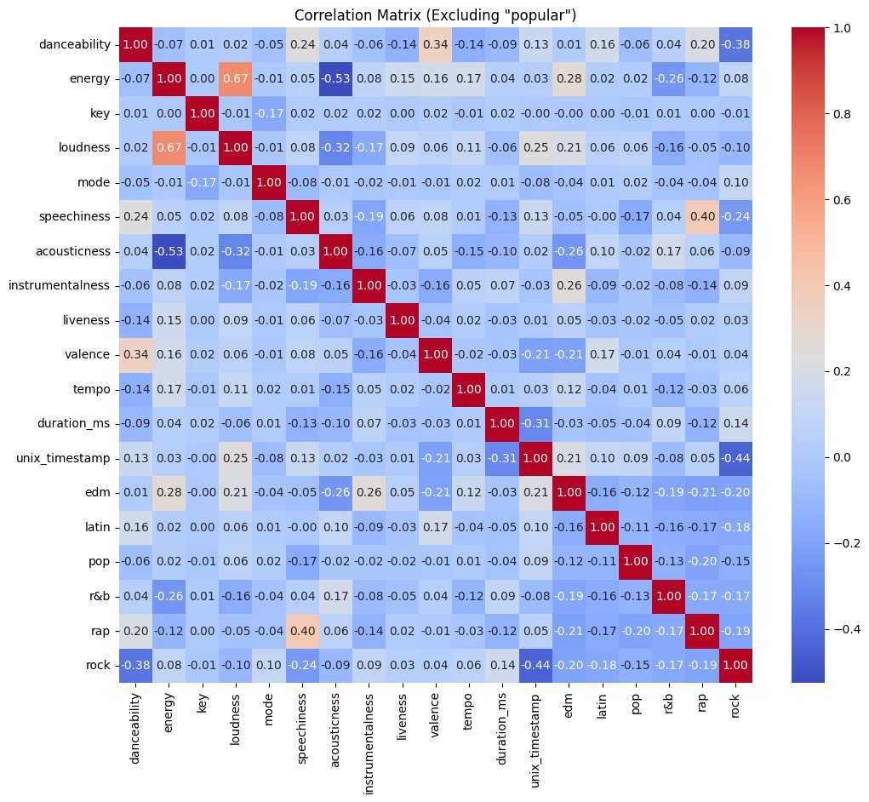
EDA Insights
01
Correlation Analysis:
energy and loudness show a strong positive correlation (~0.8), higher energy often corresponds to louder tracks.
valence and danceability are moderately correlated (~0.5), "happier" sounding tracks often have higher danceability.
Individual features have weak positive correlations with popular, suggesting no single feature fully explains popularity

Slide 8
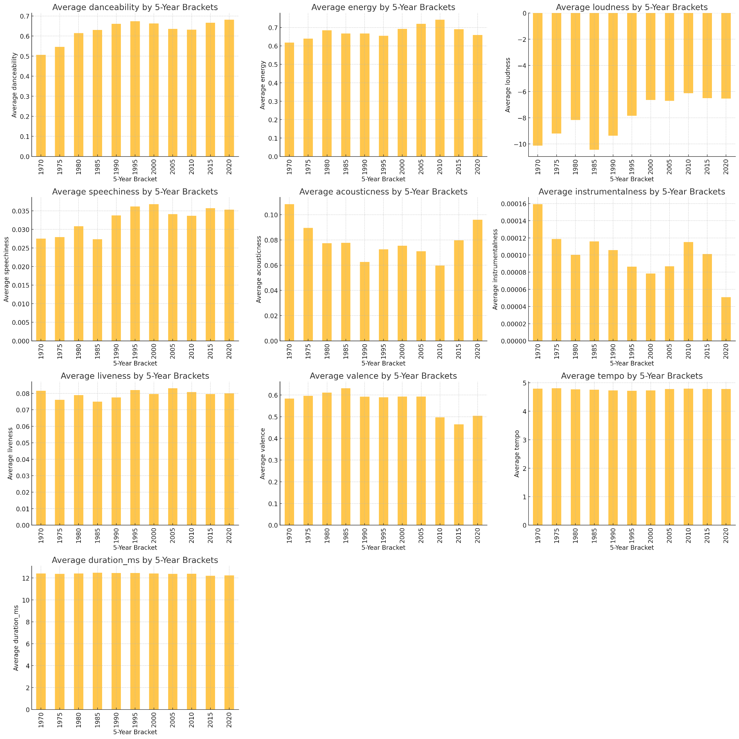
EDA Insights
02
Feature Trends:
Danceability: Increased over time, peaking post-2015, indicating a shift towards more rhythmically engaging music.
Acousticness: Post-2015 saw an increase, suggesting a preference for tracks with more acoustic elements.
Valence: Decreased consistently, reflecting a trend toward less "happy" or emotionally positive music.
Loudness: More louder tracks as they stand out and get more attention

Slide 9
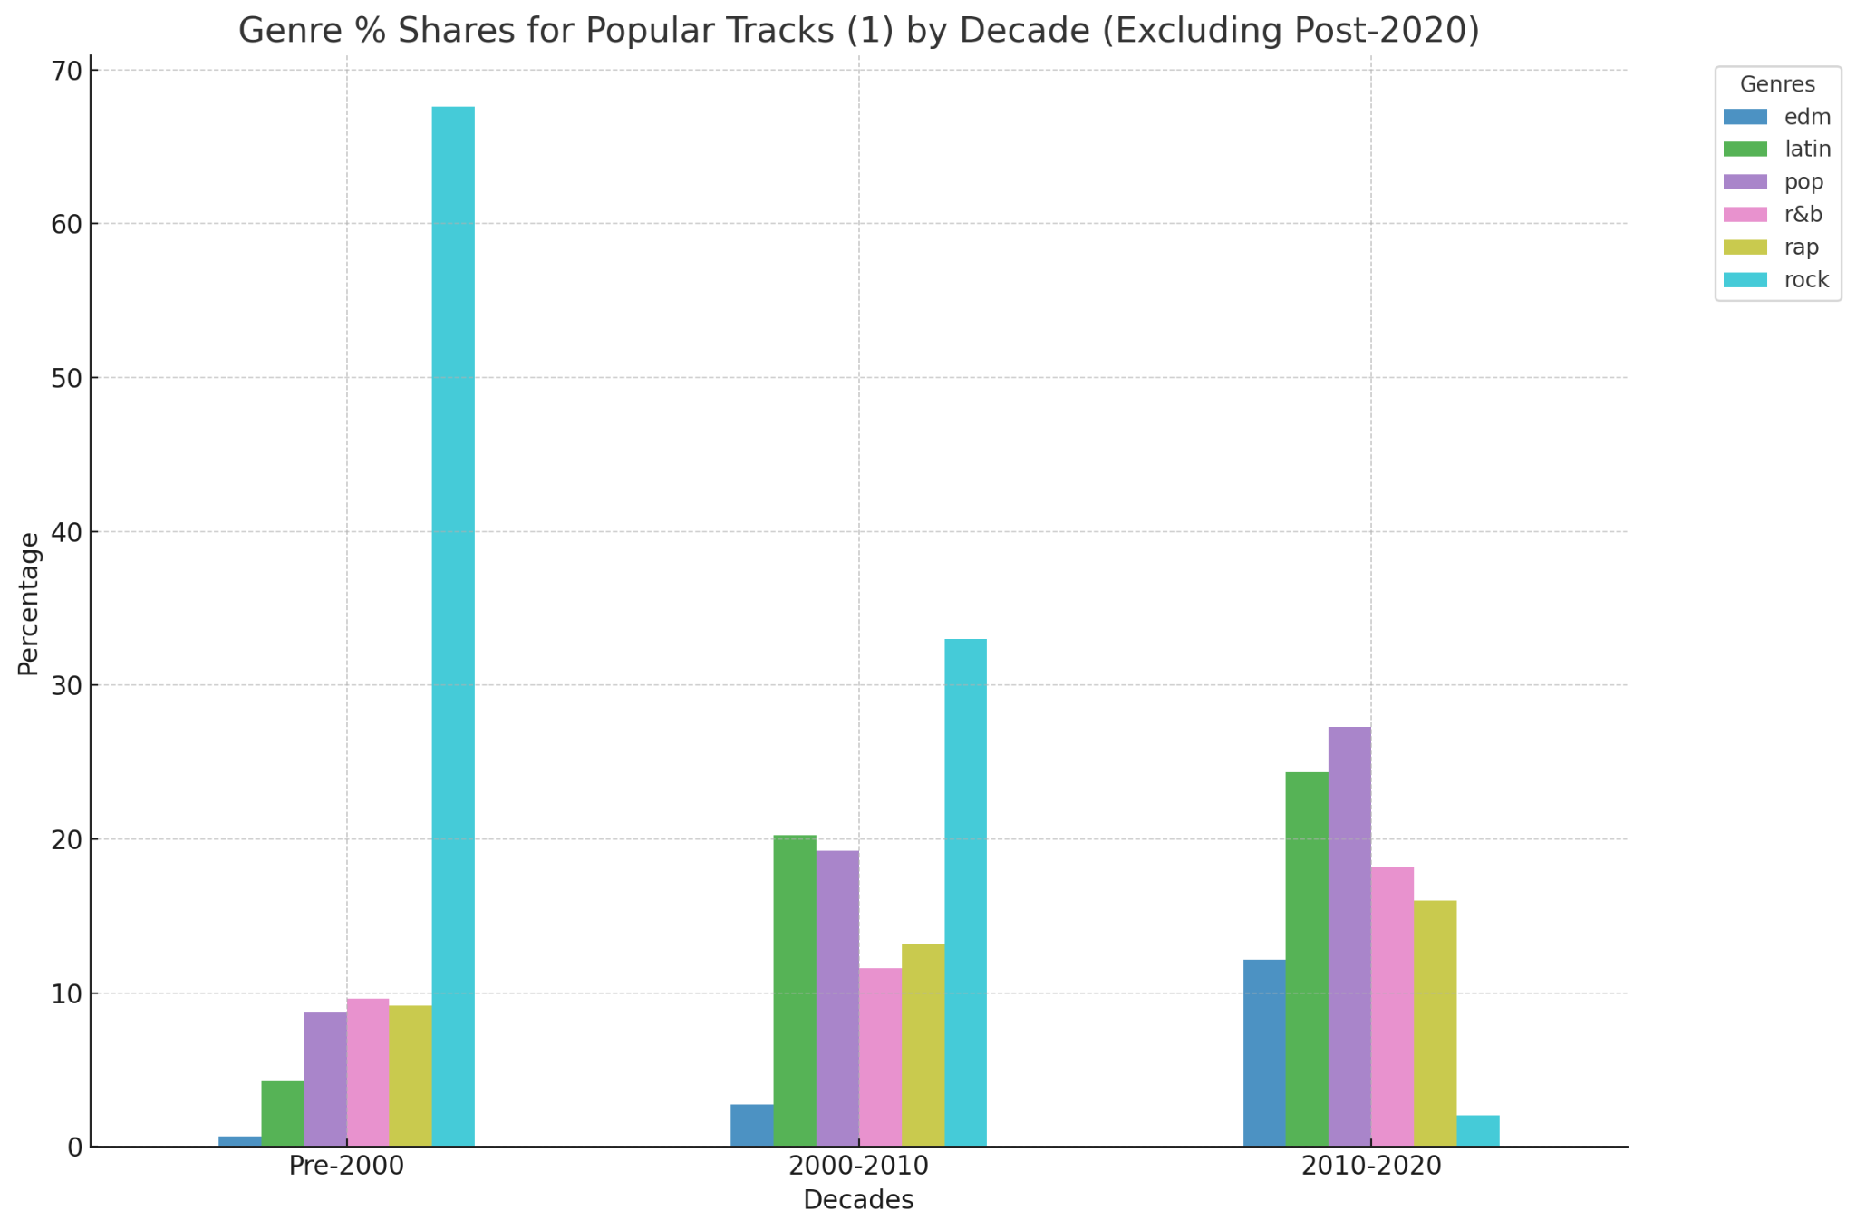
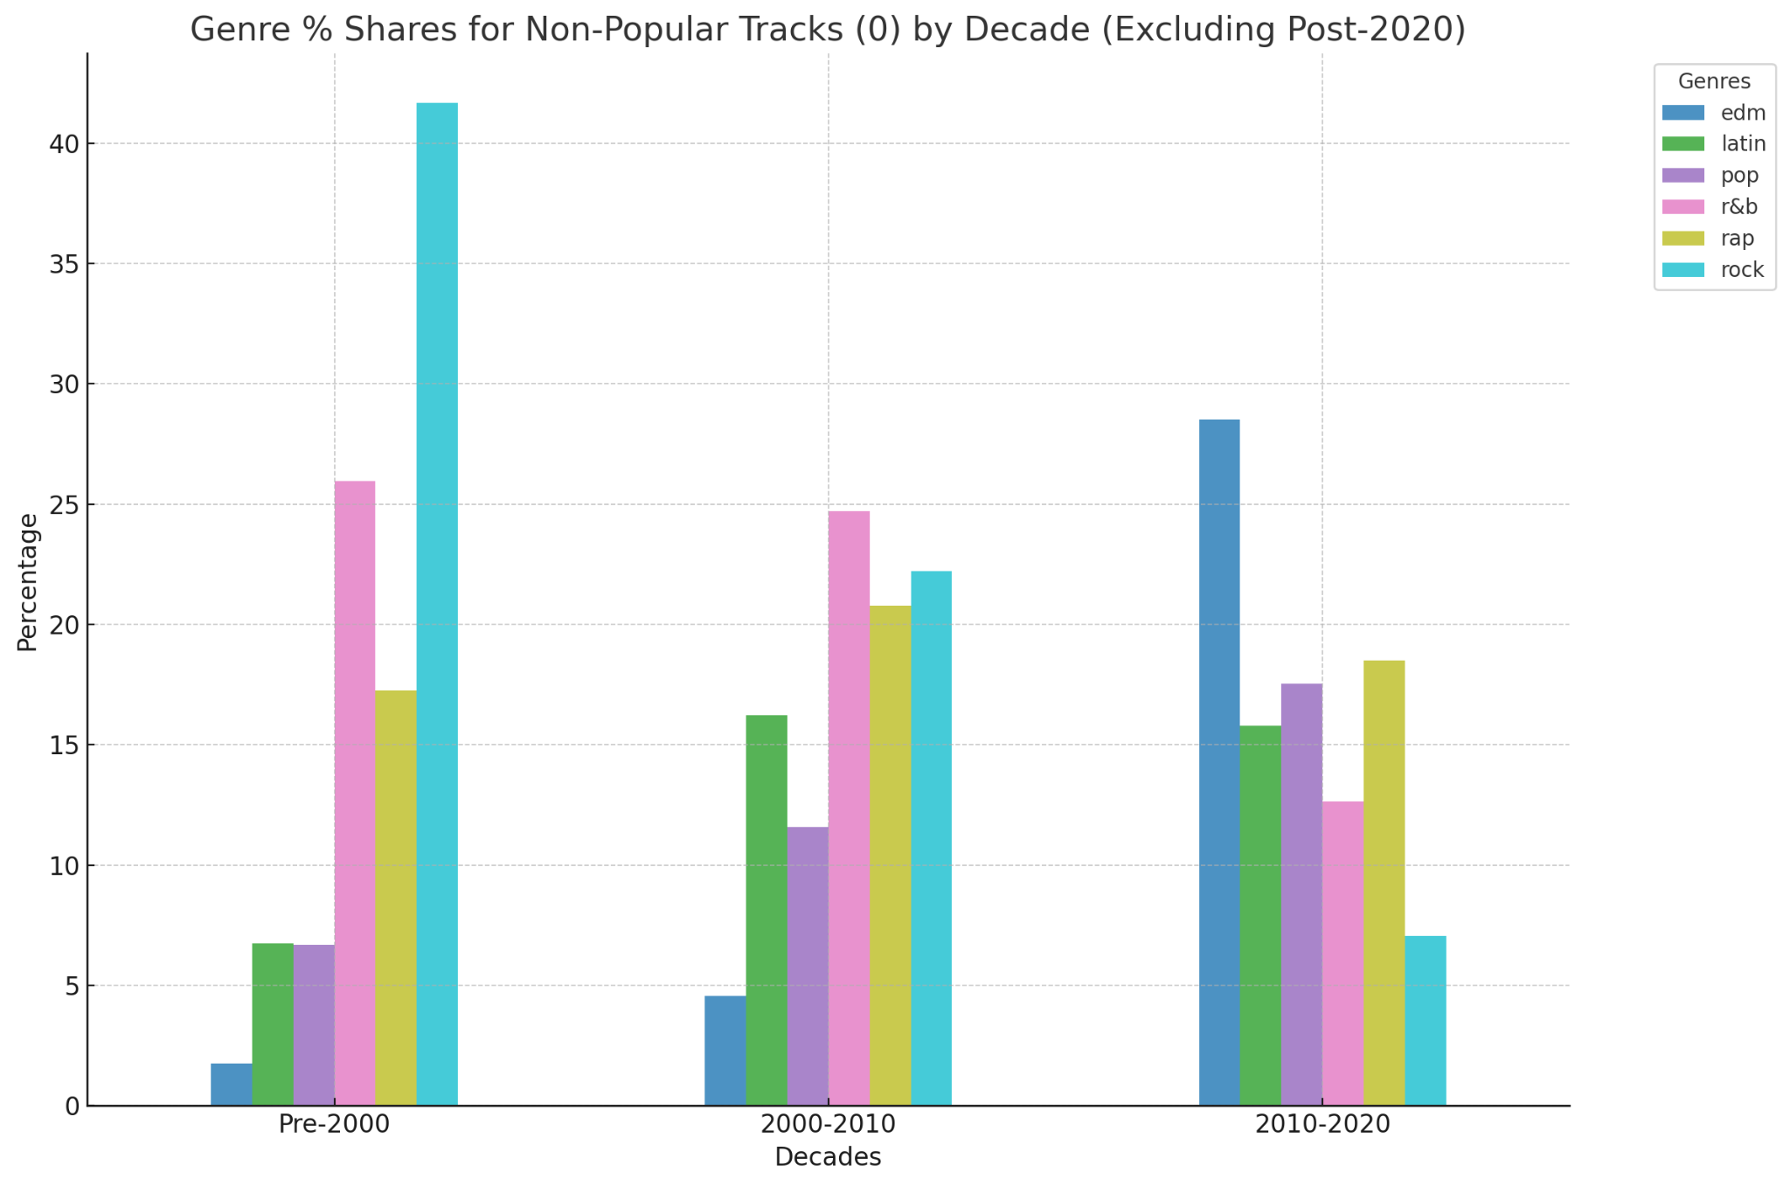
EDA Insights
03
Genre Trends:
Rock's Decline: Once the dominant genre, rock's share has decreased over time, particularly among popular tracks.
Latin and Pop's Rise: Reflects globalization and the influence of streaming platforms in popularizing these genres.
EDM Experimentation: Saw significant growth in the 2010s, but many tracks failed to break into the popular category.

Slide 10
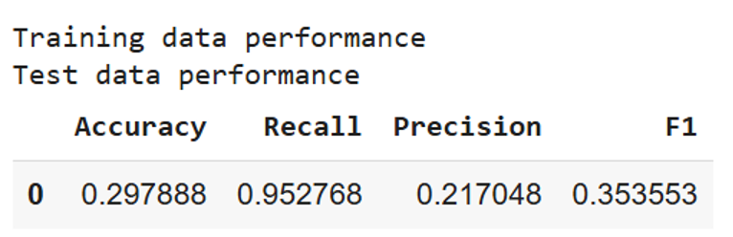
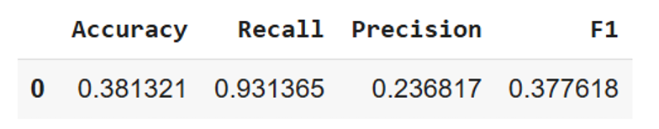
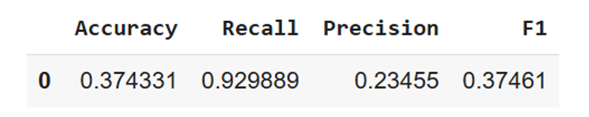
01
Regression
Outliers Removal
Interactions
Backward Selection

Slide 11
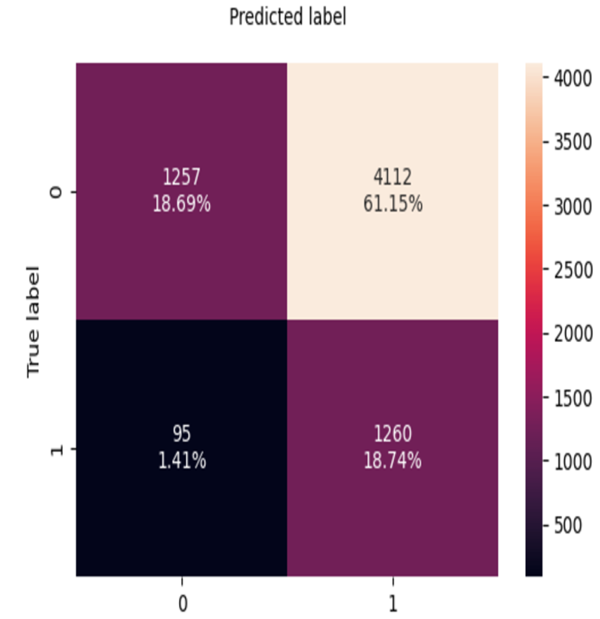
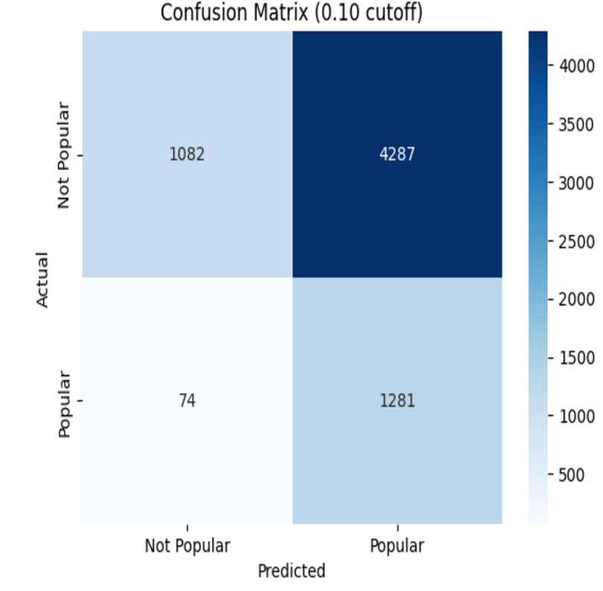
01
Regression
Backward Selection
Standardized

Slide 12
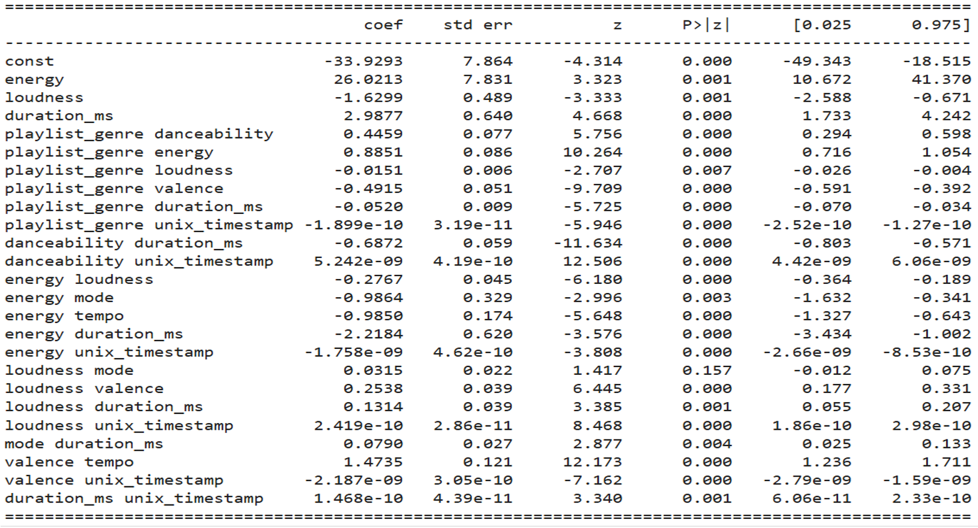
01
Regression

Slide 13
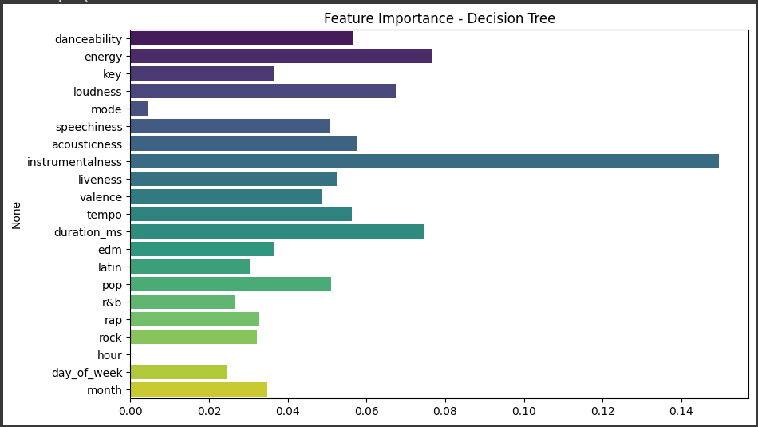
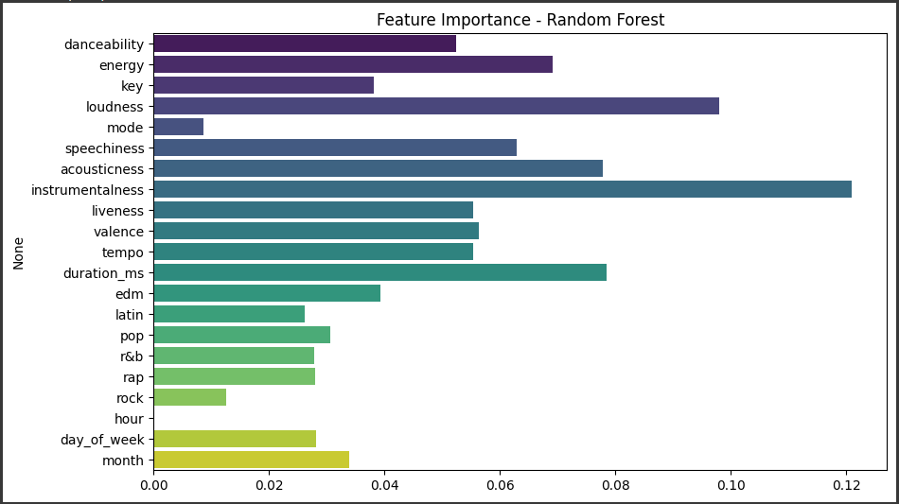
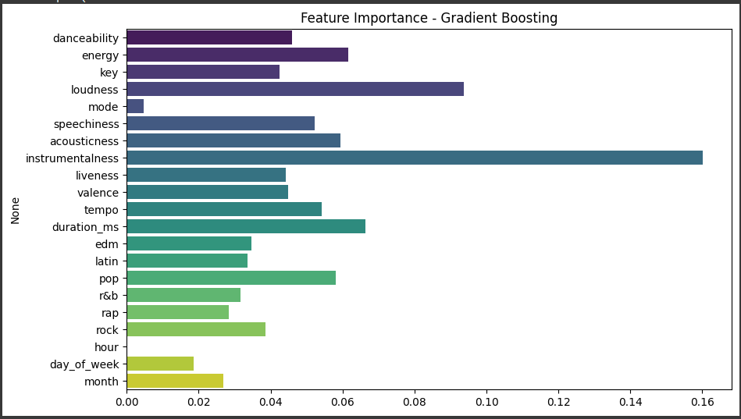
02
Decision Trees
Why Decision Tree?
Simplicity & Interpretability: Easy to interpret and visualize, making it ideal for understanding the decision-making process.
Key Insights: Excellent feature interaction capture for features like energy, loudness, and instrumentalness.
Feature Importance for Models:
Decision Tree: Instrumentalness, Energy, Duration_ms, Loudness, Acousticness
Random Forest: Instrumentalness, Loudiness, Duration_ms, Acoustiness, Energy
Gradient Boosting: Instrumentalness, Loudness, Duration_ms, Energy, Acoustiness
Key Metrics for the Models:
Model | Accuracy | Recall | Precision | F1 Score
Decision Tree | 86.3% | 49.2% | 35.5% | 41.3%
Random Forest | 89.4% | 47.2% | 49.3% | 48.2%
Gradient Boosting | 90.6% | 42.6% | 44.9% | 43.7%
Notes:
The results indicate the following:
Expected Payoff (2a - Immediate Popularity):
$8,151,000: This is the total expected payoff based on the Decision Tree model's immediate popularity predictions. It assumes only the songs predicted as popular within two months contribute to the revenue.
Expected Payoff (2b - With Delayed Popularity):
$14,479,800: This incorporates the 20% chance that unpopular songs may gain popularity later. This adjustment adds additional revenue potential to the payoff calculation.

Slide 14
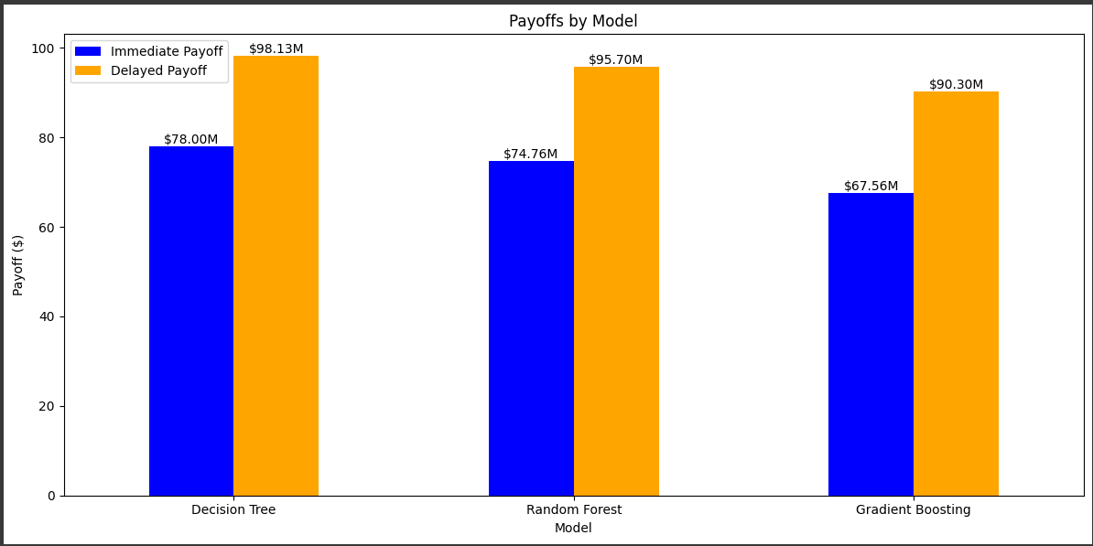
02
Decision Trees
Payoff Comparison & Business Insights
Model | Confusion Matrix (TP, FP, FN, TN) | Immediate Payoff ($M) | Delayed Payoff ($M)
Decision Tree | TP=650, FP=1211, FN=671, TN=4192 | $78.00M | $98.13M
Random Forest | TP=623, FP=642, FN=698, TN=4761 | $74.76M | $95.70M
Gradient Boosting | TP=563, FP=441, FN=758, TN=4962 | $67.56M | $90.30M
Business Insights:
Impact on Delayed Payoff:
Recall captures the true positives (e.g., identifying potential hidden hits), which are crucial for maximizing delayed payoffs by promoting songs with long-term growth potential.
Balancing Immediate Payoff:
While recall improves delayed payoffs, its alignment with precision ensures accurate identification of hits, directly influencing immediate payoffs and reducing false positives.

Slide 15
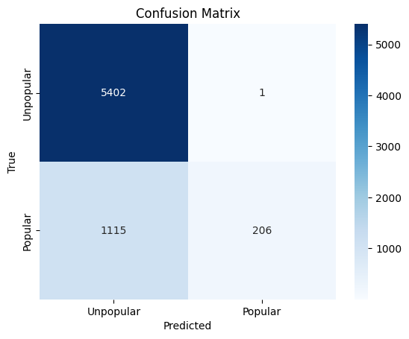
03
KNN
Key Metrics:
Accuracy: 83% (overall model correctness).
Precision (Class 1 - Popular): 1.00 (perfectly avoids labeling unpopular songs as popular).
Recall (Class 1 - Popular): 16% (struggles to identify all popular songs).
F1-Score (Class 1 - Popular): 27% (low balance between precision and recall).

Slide 16
03
KNN
Strengths:
Excellent performance in identifying unpopular songs (High precision and recall for Class 0).
Minimizes the risk of misclassifying unpopular songs as popular (only 1 false positive).
Weaknesses:
Misses a significant number of popular songs (High False Negatives).
Poor recall for popular songs impacts promotional strategies for potential hits.

Slide 17
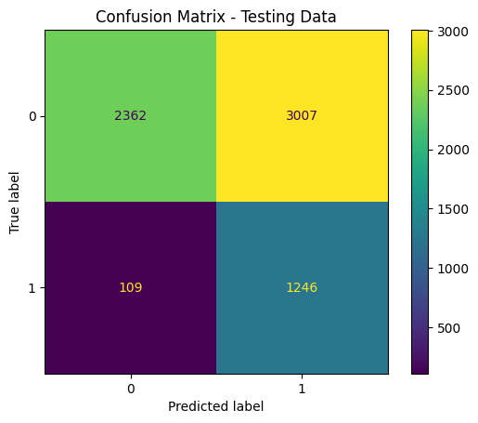
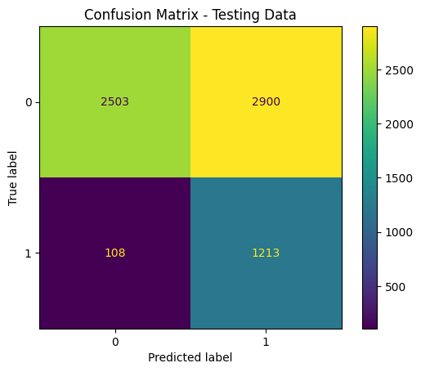
04
Neural Networks
Model Performance
We tried 2 different datasets
with dummy variables (test) with LabelEncoder (test)
Further Refinement:
Play with outliers
Play with interactions
Play with ensembles
Expected Payoff:
$120 Million
Scenario 1. Expected Payoff: $116 Million​
Scenario 1. Expected Payoff: $120 Million​
GridSearch
Best Hyperparameters: {'activation_function': 'tanh', 'dropout_rate': 0.4, 'num_layers': 2, 'num_neurons': 128, 'optimizer': 'sgd'}
Cutoff: 0.08
GridSearch
Best Hyperparameters: {'activation_function': 'relu', 'dropout_rate': 0.4, 'num_layers': 2, 'num_neurons': 64, 'optimizer': 'adam'}
Cutoff: 0.118

Slide 18



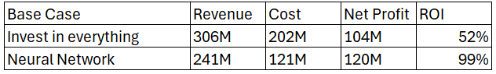
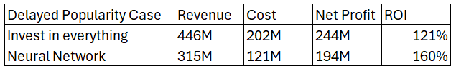


Recommendations
We recommend Spotify adopt the neural network model for its promotional strategy.
As you can see the neural network model consistently delivers a higher ROI while maintaining budget flexibility and scalability. With this approach, Spotify maximizes profit potential and reduces risks associated with over-investment in less promising tracks.

Slide 19

Thank
You

